Slide 1



Canadian Physicians for Aid and Relief
ACADEMIC ALLIES

Slide 2


Table Of Contents
01.
03.
05.
About CPAR
Green Schools Network
Fundraising Ideas
02.
04.
06.
What We Do
Academic Allies
Contact Us

Slide 3
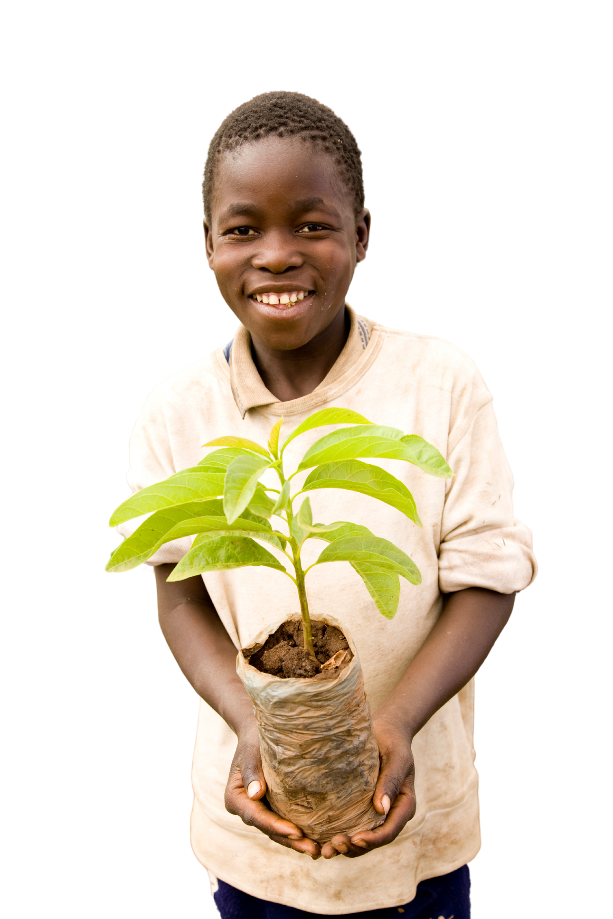


About CPAR
Founded in 1984 in response to the famine in Ethiopia, Canadian Physicians for Aid and Relief (CPAR) is a non-profit organization working in partnership with health professionals, vulnerable communities, governments and diverse organizations to build healthy communities in Africa.
Our Purpose
Over the decades since it was founded in 1984, much of CPAR’s work has addressed the social and environmental determinants of health so that families have enough nutritious food to eat, livelihoods to support them, and access to clean water. CPAR believes it is the interconnection between the health system and social determinants of health that determines the well-being of individuals and communities.
Our Mission
Building health system capacity and supporting healthy lives in low resourced regions.
Agriculture
App
Our Vision
Stronger health systems in Africa.

Slide 4
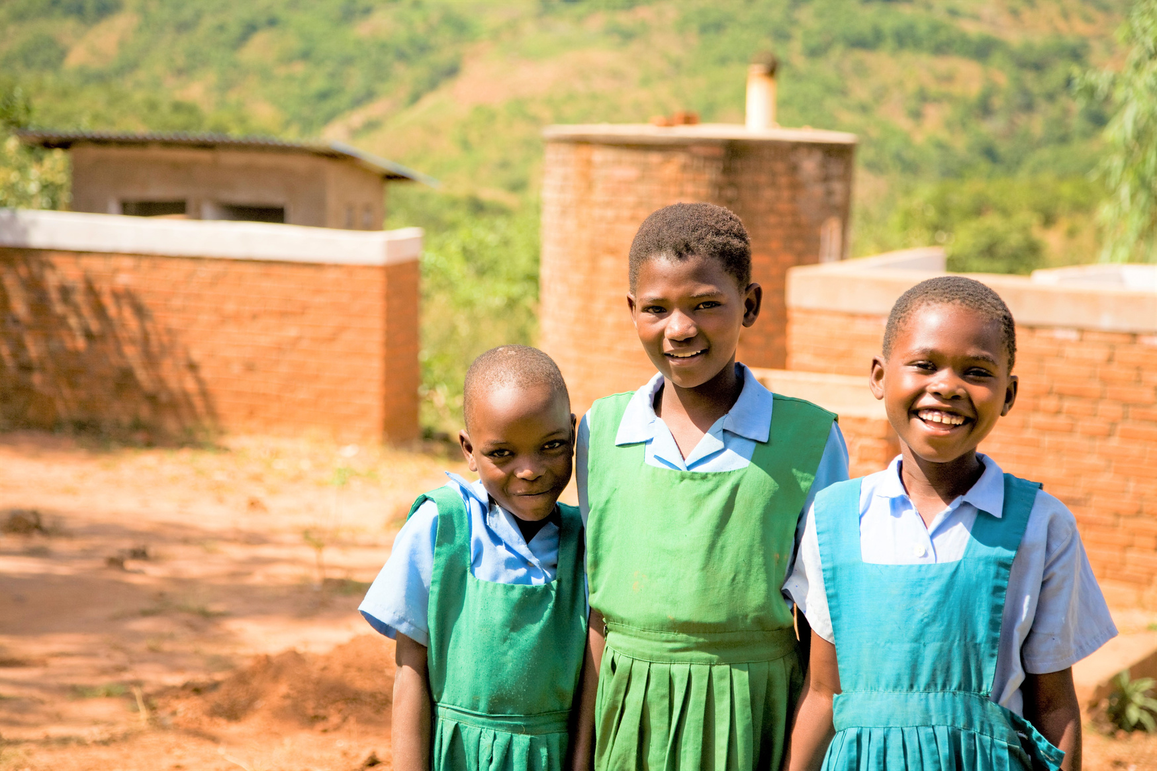
Green Schools Network
Introduction
  The Green Schools Network (GSN) is an integrated project focused on Water, Sanitation, and Hygiene (WASH) and nutrition in Malawi.
  It aims to address critical challenges such as contaminated water sources, irrigation problems, and decreased crop production.
  The GSN project involves the construction of essential infrastructure including rainwater harvesting tanks, latrines, changing rooms, and handwashing stations.
  It promotes sustainable agriculture practices and establishes gardens with fresh fruits and vegetables to combat nutritional deficiencies.
  The project facilitates lessons on safe sanitation and hygiene behaviors, including menstrual hygiene management (MHM).

Slide 5
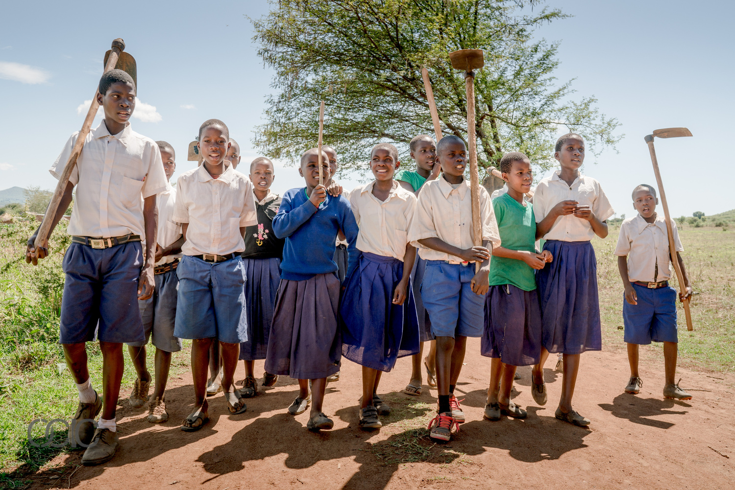
Green Schools Network
Challenges
Primary schools in rural Malawi encounter numerous challenges that hinder the delivery of quality education and overall well-being of students. Among these challenges are:
  Water Scarcity: Many schools struggle with accessing sufficient clean water for drinking, cleaning, personal hygiene and irrigation.
  Malnutrition: Poor dietary habits and limited resources lead to malnutrition among students, exacerbated by climate change impacts such as inconsistent rainfall patterns affecting crop yields.
  Inadequate Educational Resources: Schools often lack essential materials, educational training, and infrastructure necessary for providing a conducive learning environment.

Slide 6
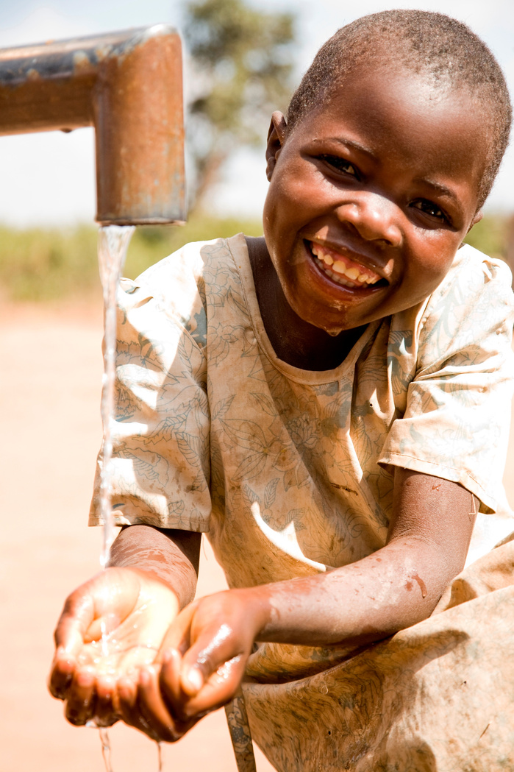
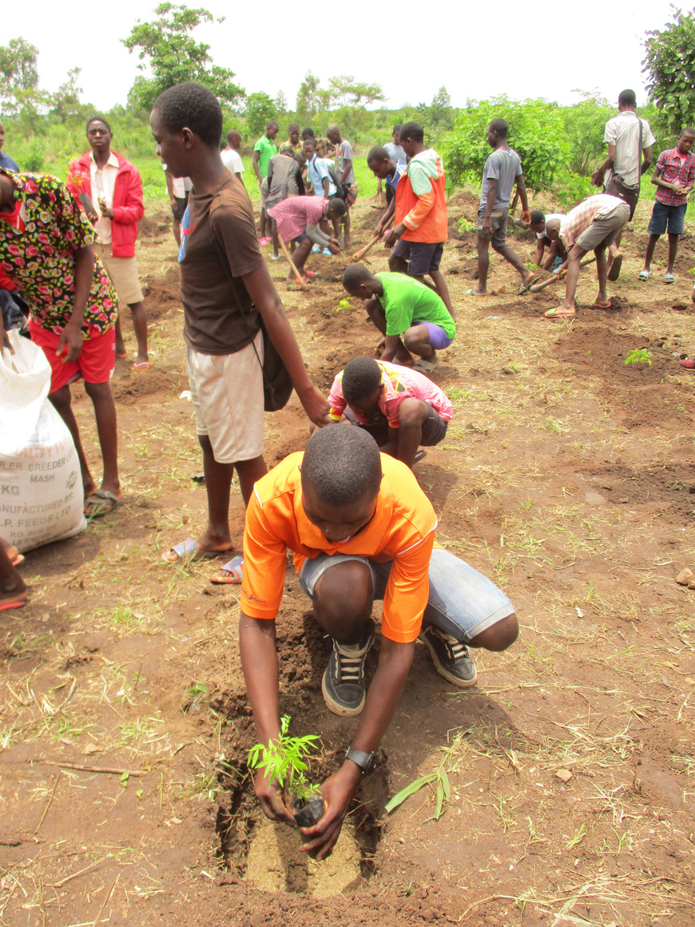
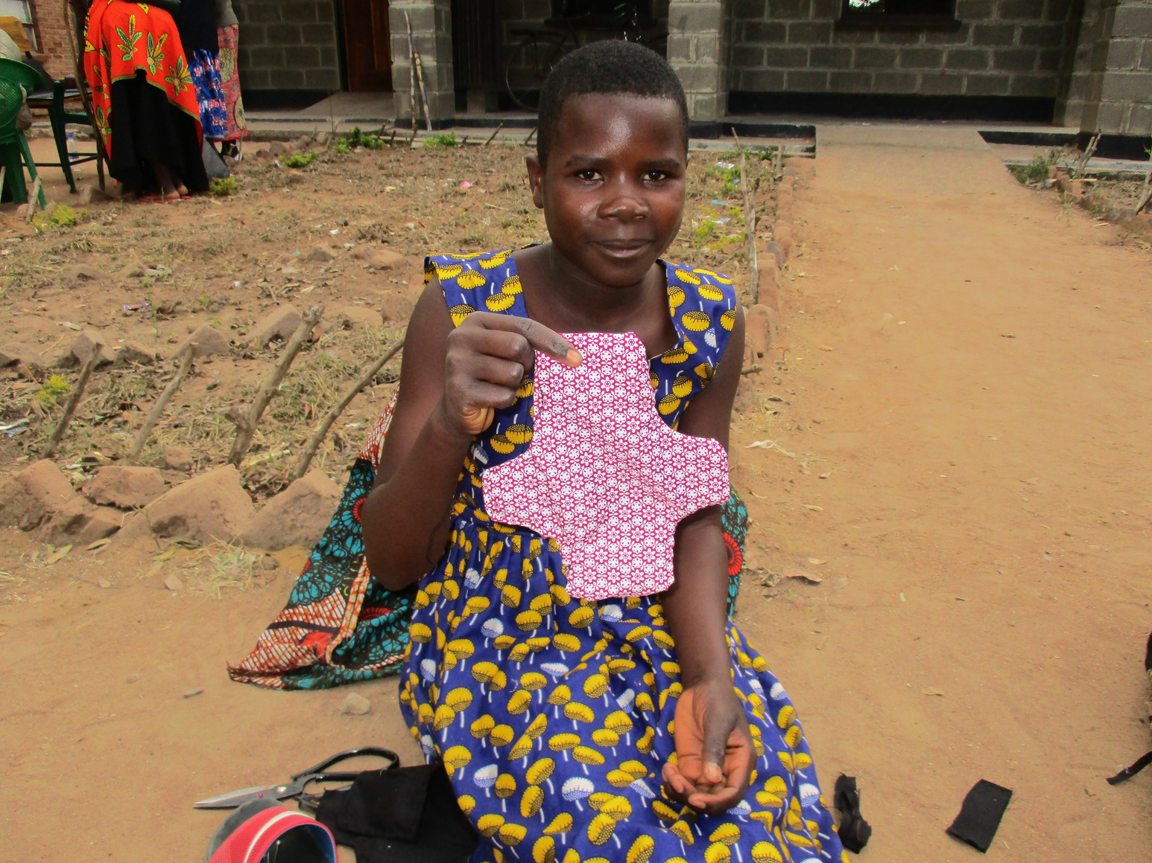
Reduce school absenteeism, particularly among female students, and improve health and education outcomes.
Green Schools Network
Objectives
Improve access to safe drinking water, sanitation facilities, and nutrition for primary school students, teachers, and surrounding community members.
Empower communities to practice sustainable agriculture, mitigate climate change effects, and adopt safe WASH and MHM behaviors.

Slide 7
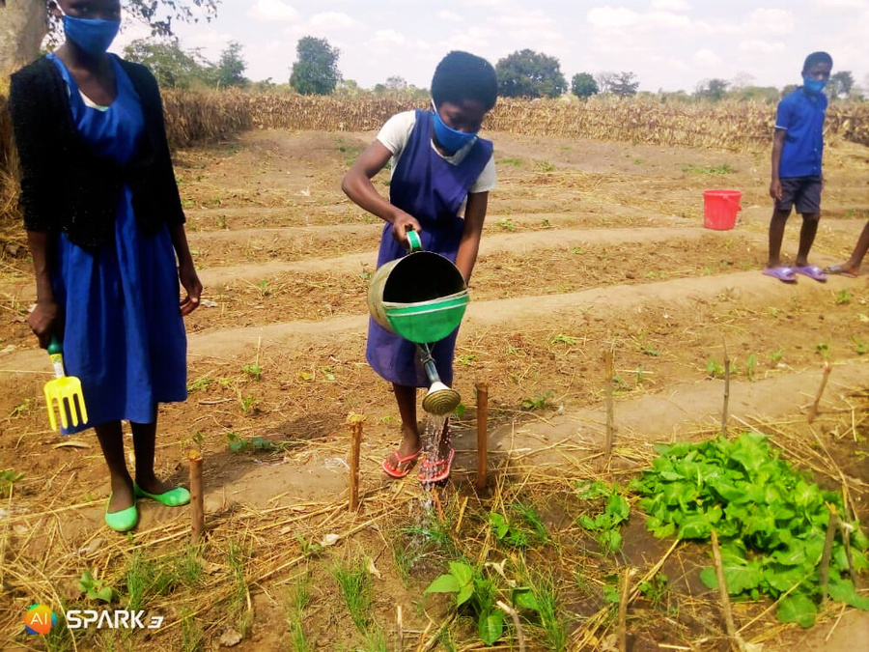
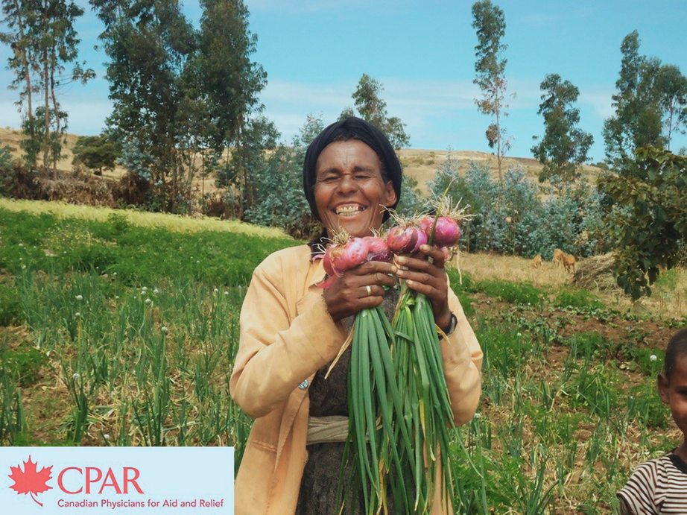
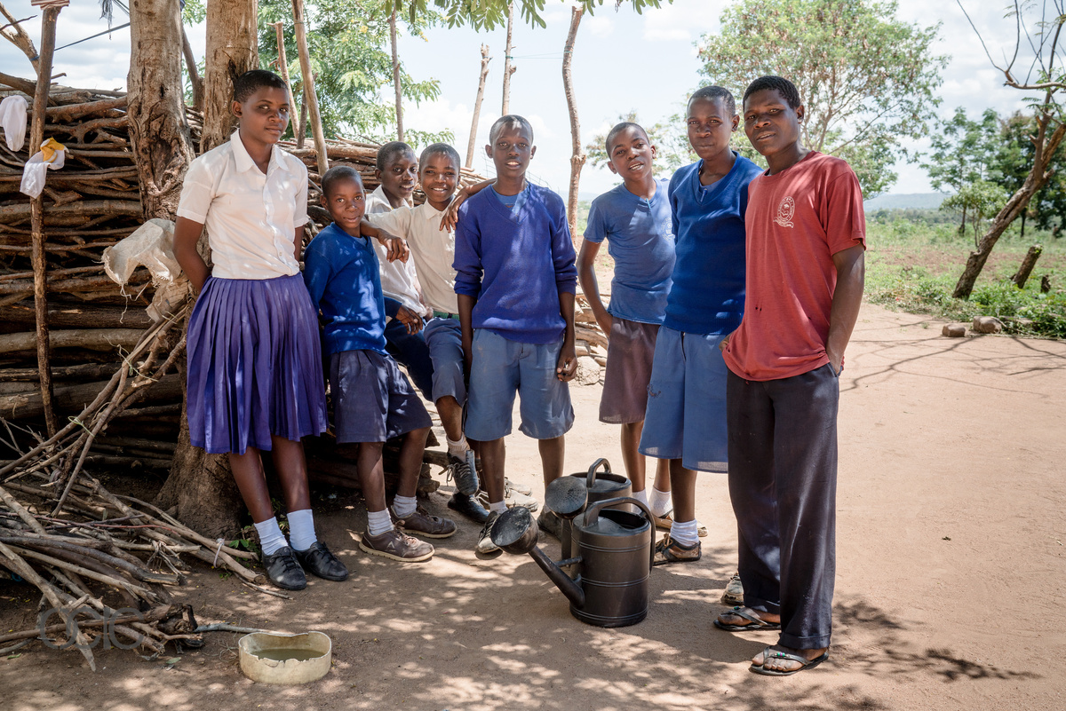
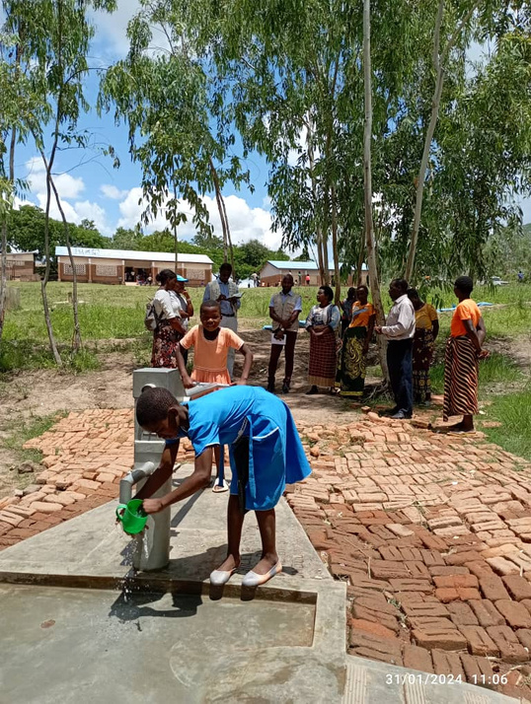
Green Schools Network
Outcomes
School gardens will help combat malnutrition by providing nutritious food for students and the surplus can be sold in local marketing generating revenue.
Schools will have access to safe drinking water, improved Sanitation and Hygiene services along with increased MHM knowledge and product availability. Absenteeism and dropout rates in schools are reduced.
Transfer of knowledge occurs as students share their agricultural knowledge with their communities leading to enhanced food security among the targeted population.
Schools achieve Open Defecation Free (ODF) status.

Slide 8
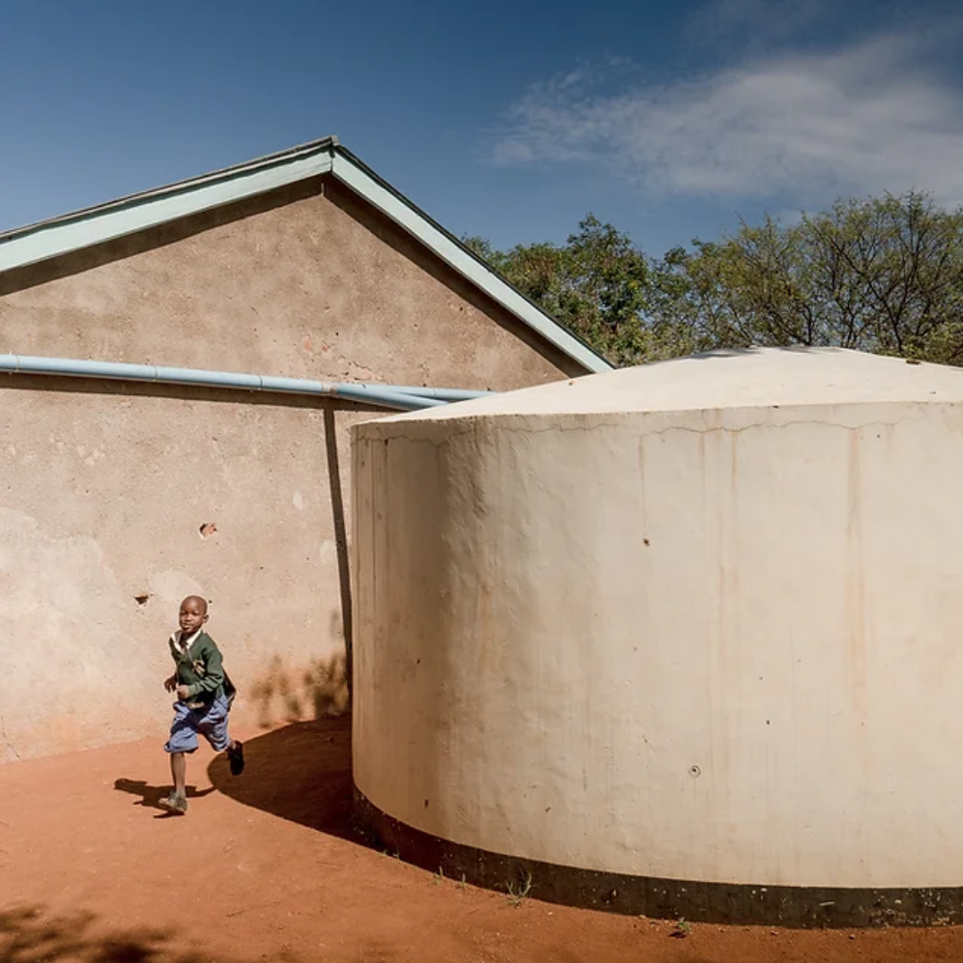
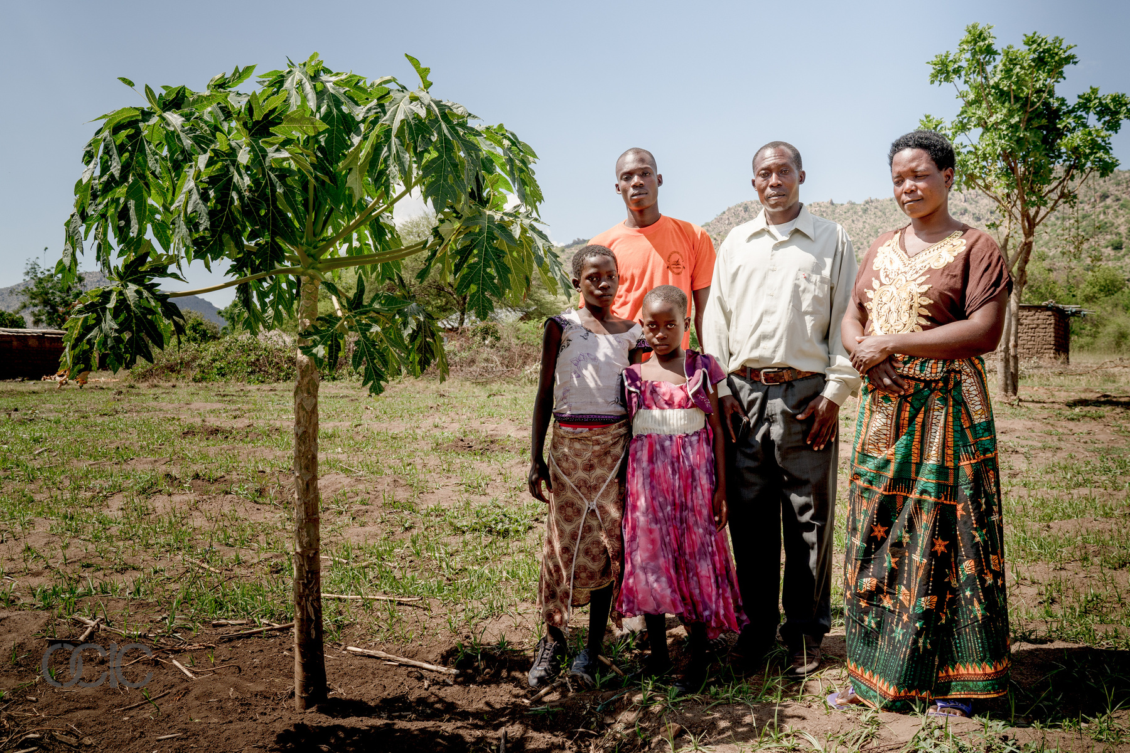
Green Schools Network
Impact and Expansion
  As of 2024, there are 13 primary schools supported by the Green Schools Network in Malawi.
  With plans for expansion, the project will continue in the Lilongwe district of Malawi from January 2024 to January 2027.
  The ultimate goal is to empower students, teachers, and their families to improve their well-being and contribute to sustainable development.
  What started as a simple rainwater harvesting project in 2017 has evolved into a comprehensive support system, encompassing water, sanitation, nutrition, and educational training.

Slide 9
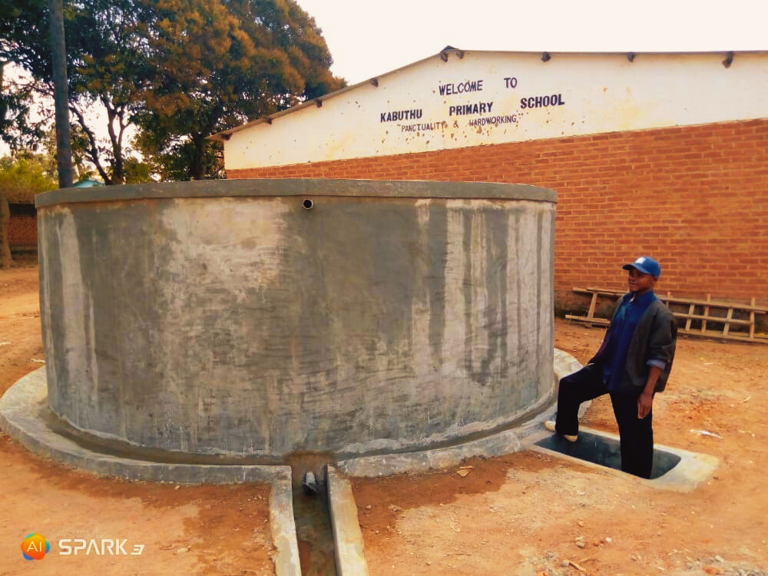
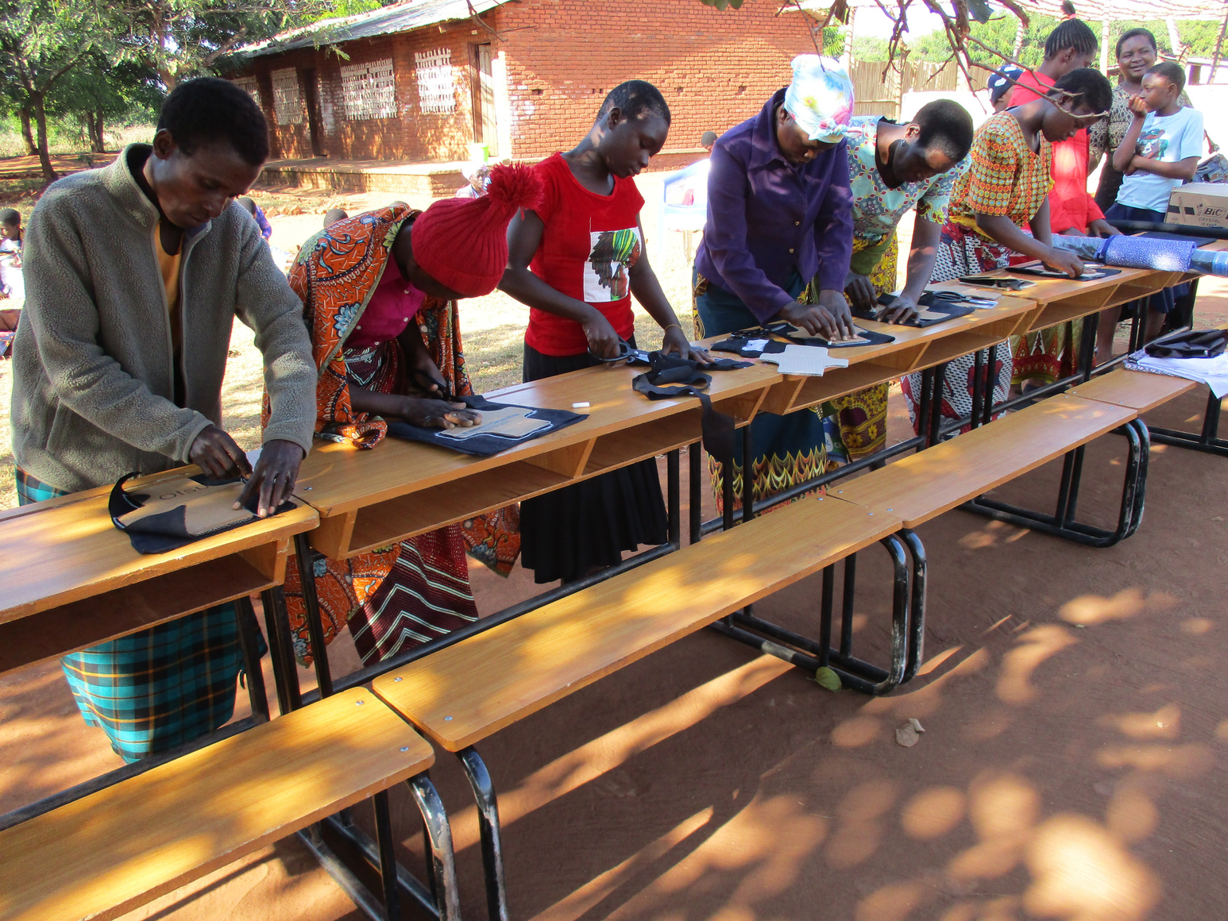


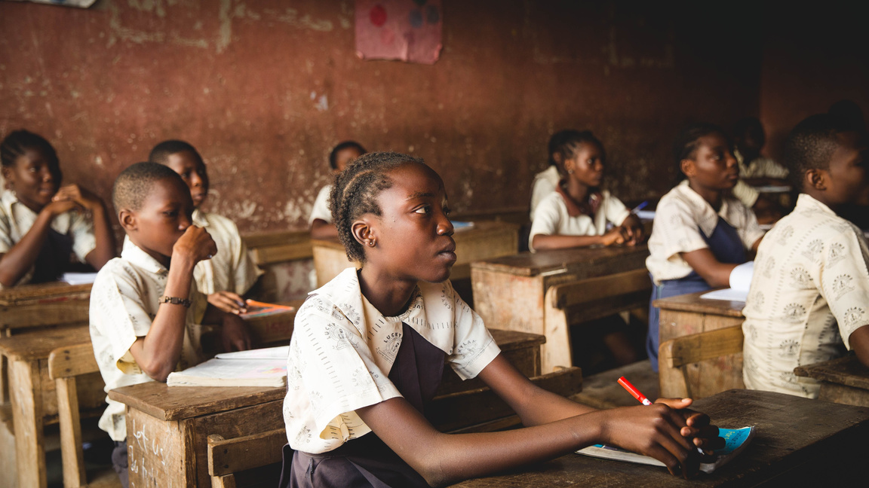
Academic
Allies
Program

Slide 10

Academic Allies Program
CPAR’s role:
  The Academic Allies Program establishes connections between Canadian students and primary school students in Malawi through the Green Schools Network, offering a unique opportunity to make a meaningful impact through fundraising initiatives.
  Students gain valuable insights into the adversities faced by children in regions like Malawi, including challenges such as water scarcity, malnutrition, and limited access to education resources.
  We connect each Canadian school with a primary school in Malawi and provide pictures, stories and a live interactive session so you know exactly where your donated funds are going.
  This approach allows Canadian students to directly interact with the Malawian students they support, fostering a deeper understanding of how their fundraising efforts in Canada positively influence the well-being and educational opportunities of disadvantaged children.

Slide 11



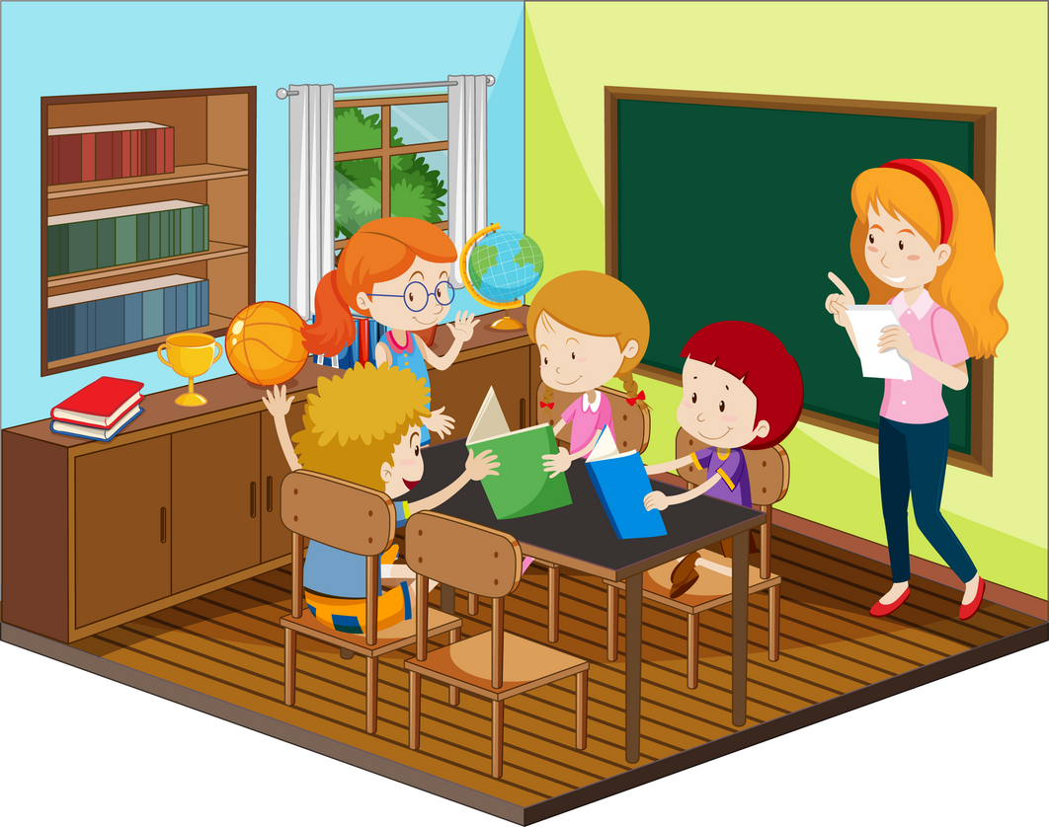
Academic Allies Program
School’s Role:
Contact CPAR at info@cpar.ca or (416) 369-0865 to pledge your class/school support.
Start fundraising!
Donate your raised funds to CPAR and receive regular project updates.
Schedule a virtual or in-person presentation by CPAR.

Slide 12




Academic Allies Program
Fundraising Ideas
Virtual Events: Organize virtual talent shows, online auctions, or fundraising challenges.
Social Media Campaigns: Leverage social media platforms like TikTok to raise awareness and funds for the cause
Community Outreach: Host bake sales, car washes, or other community events to engage local support.
Be creative: Think outside the box and leverage talents and resources for a meaningful cause.

Slide 13

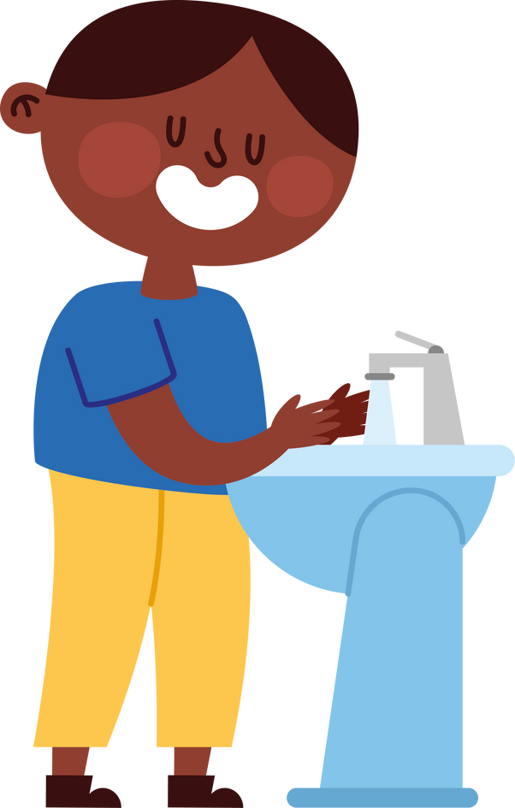

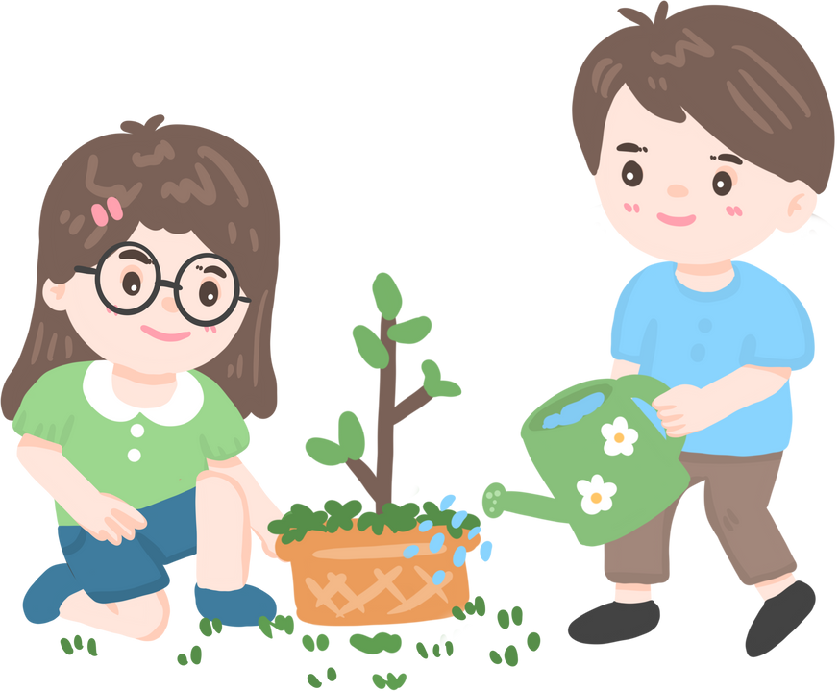
Academic Allies Program
Fundraising Benchmarks
Raise $2000 to purchase re-usable menstrual hygiene products in schools
Raise $525 for construction of ONE change room with a handwashing station
Raise $10,000 for construction of ONE 30,000L rainwater harvesting tank
Raise $500 for purchase of vegetable seeds, fruit and plant seedlings to develop a small school garden
Raise $5000 to build VIP latrine blocks on school campus

Slide 14


Connect With CPAR
416-369-0865
www.cpar.ca
240 Bank St
Ottawa, ON K2P 1X4
info@cpar.ca

Slide 15
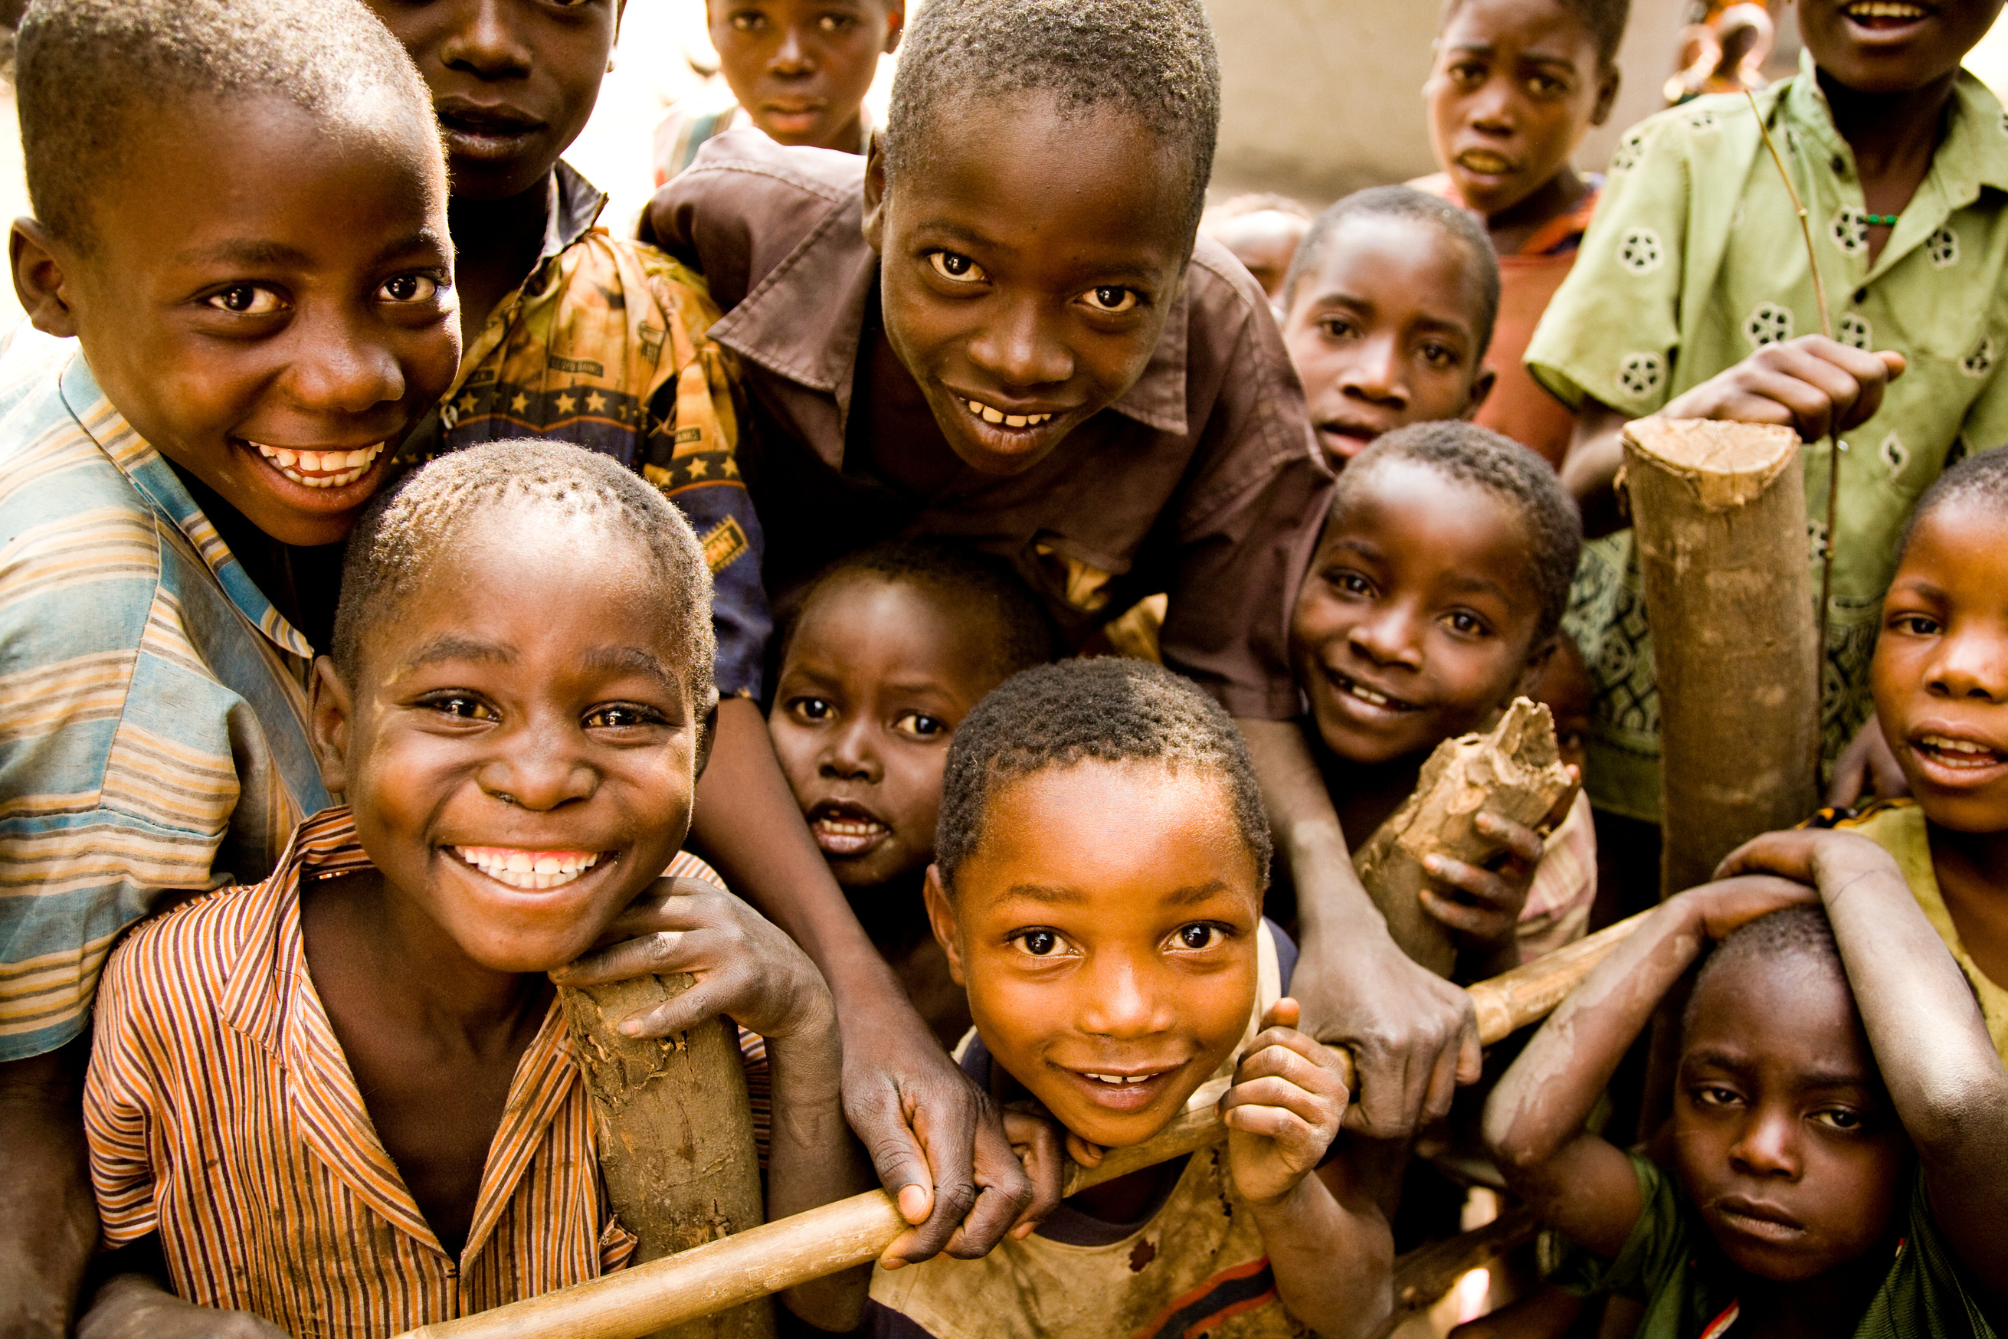




THANK YOU!
Follow Us On Social Media
@cparcanada
@Canadian Physicians for Aid and Relief (CPAR)
@cparcan
@CPARCanada

